Slide 1
AI based motion control
3.4 Jin Lexuan

Slide 2
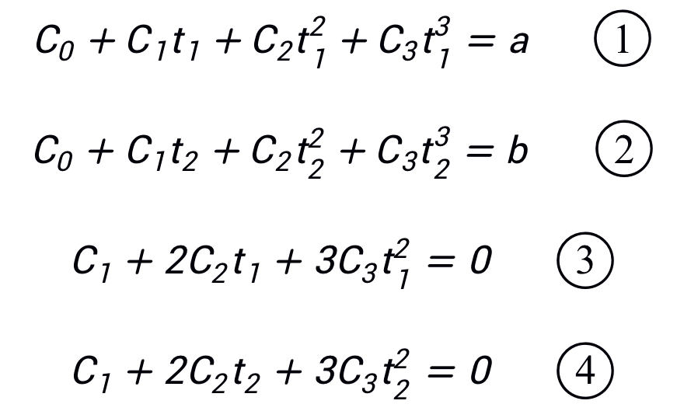
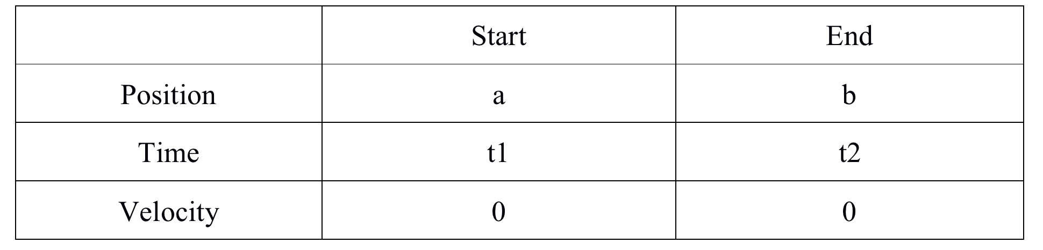
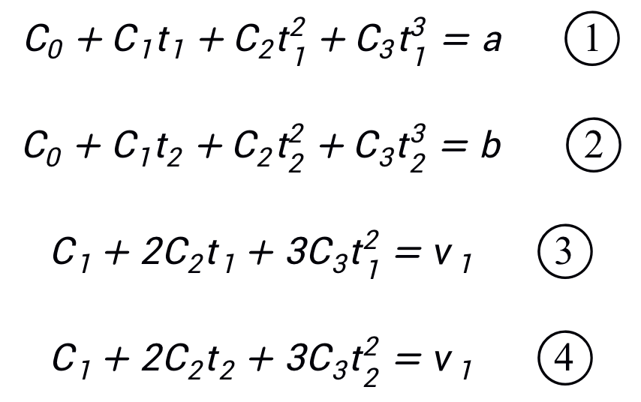
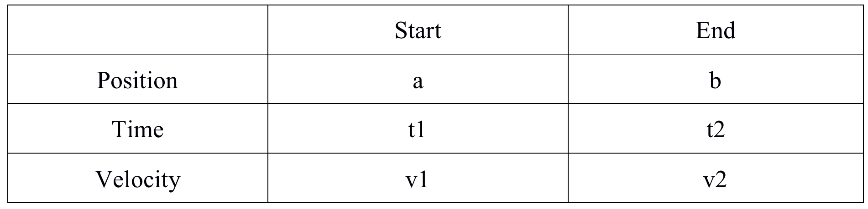
Change of equation condition

Slide 3
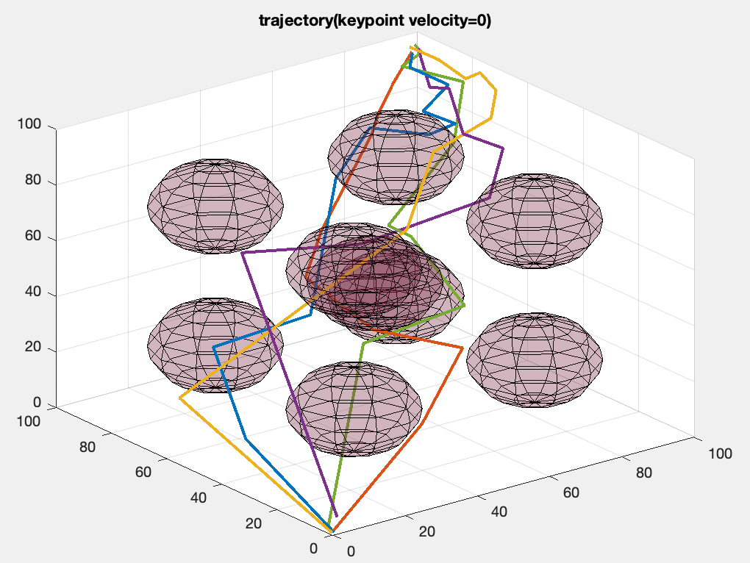
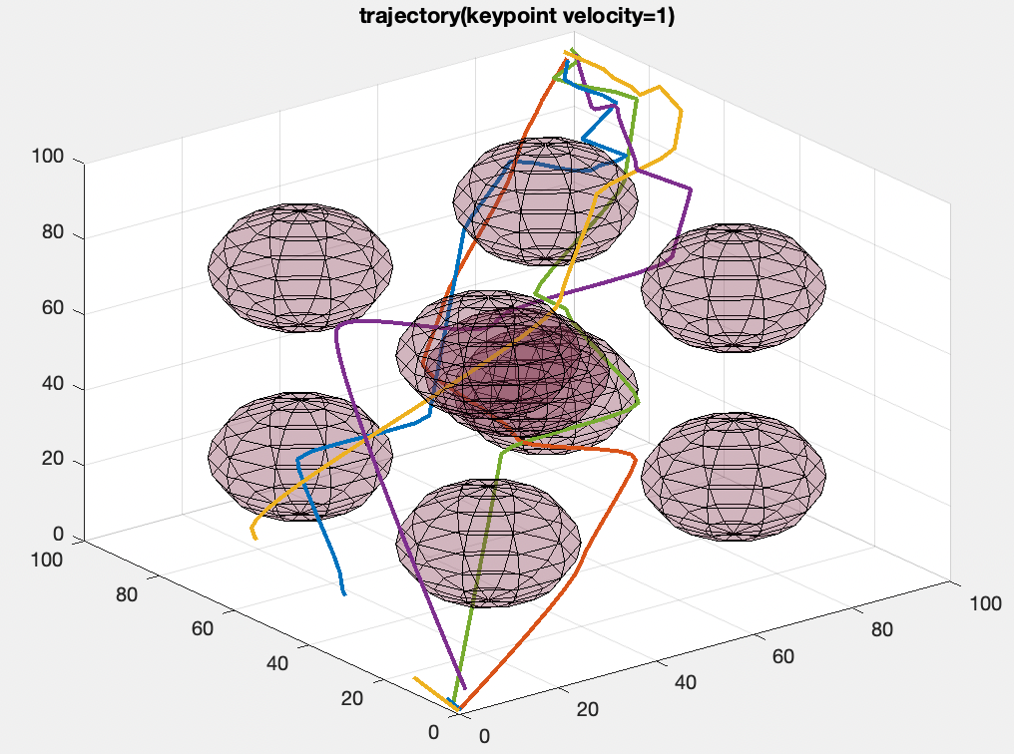
Increase Velocity => Change of trajectory => out of range / collision

Slide 4
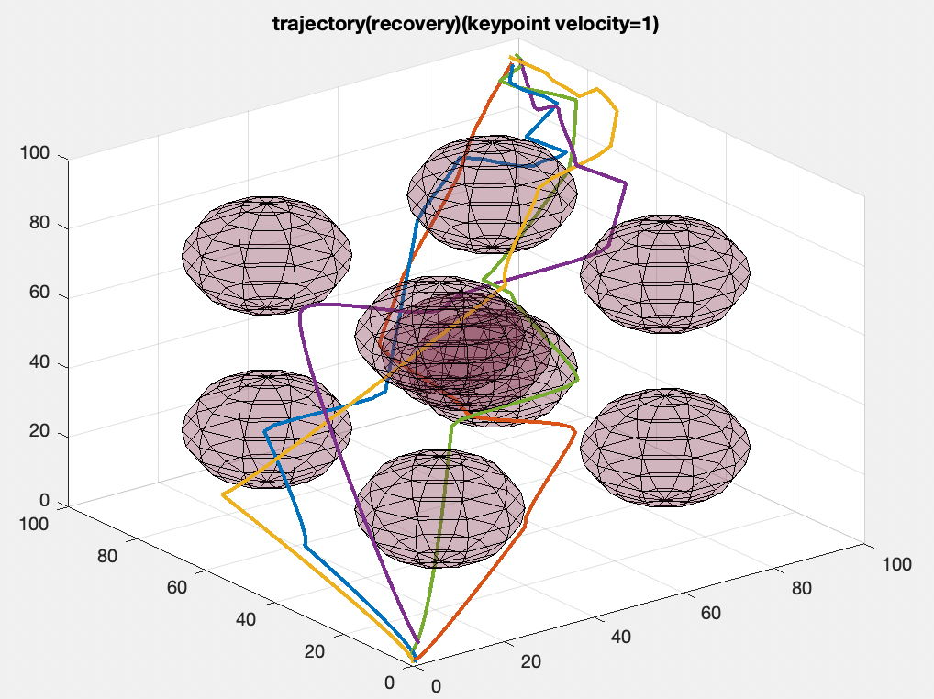
Method 1: fixed velocity or 0 velocity
1. Set an expected velocity for each keypoint.
2. Calculate trajectory with the velocity at the keypoint
3. If collision or out of range happens, use the trajectory with 0 velocity at keypoint. Otherwise, keep the trajectory.

Slide 5
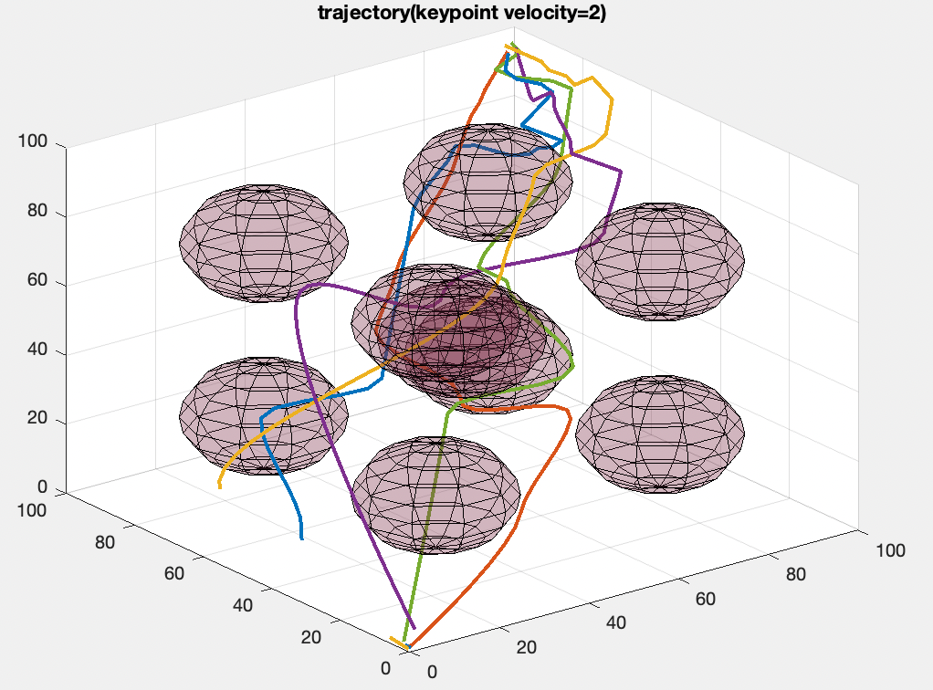
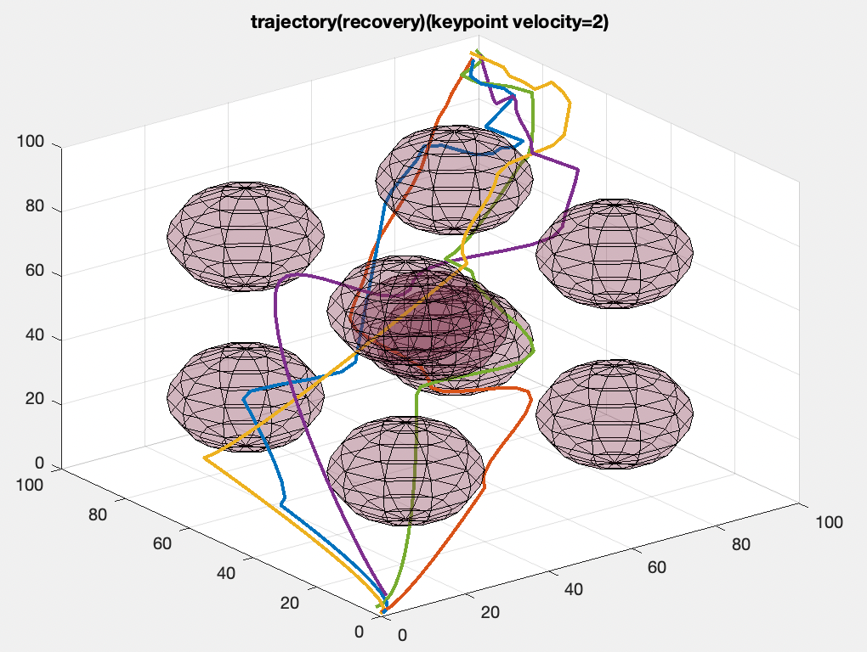
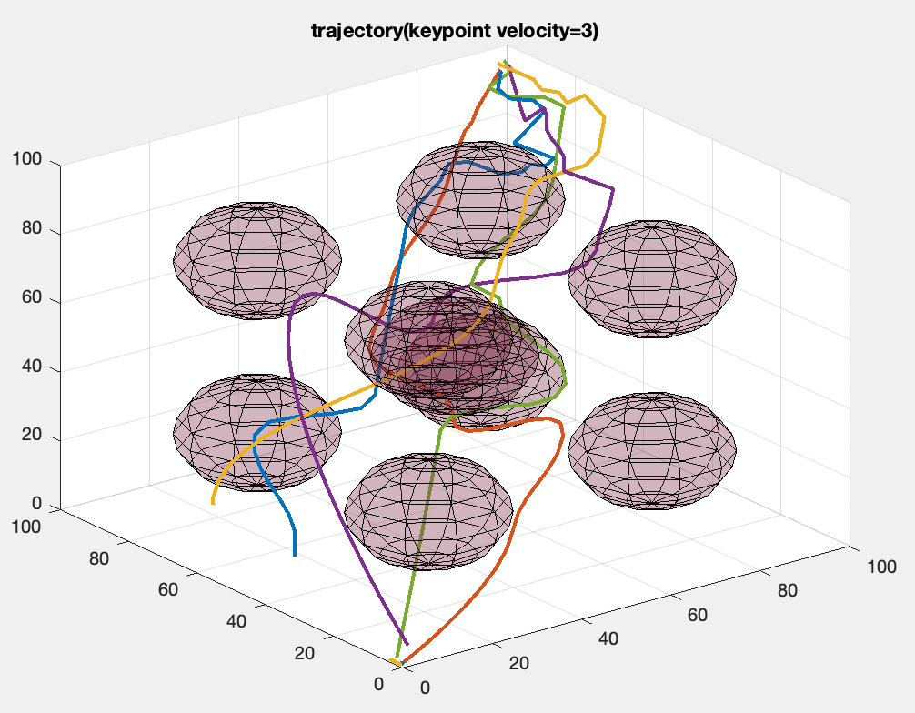
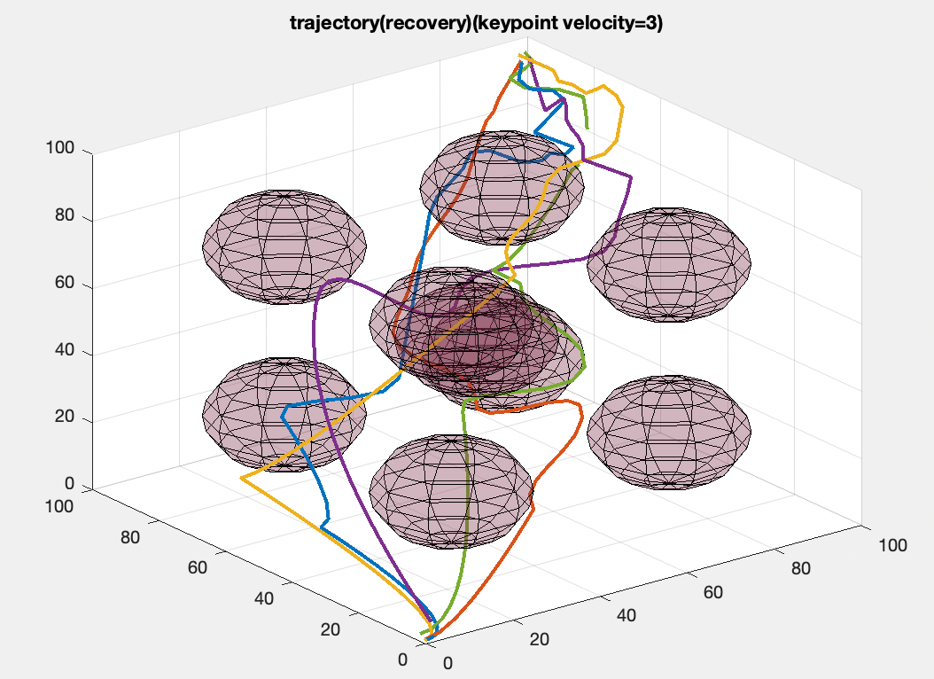

Slide 6
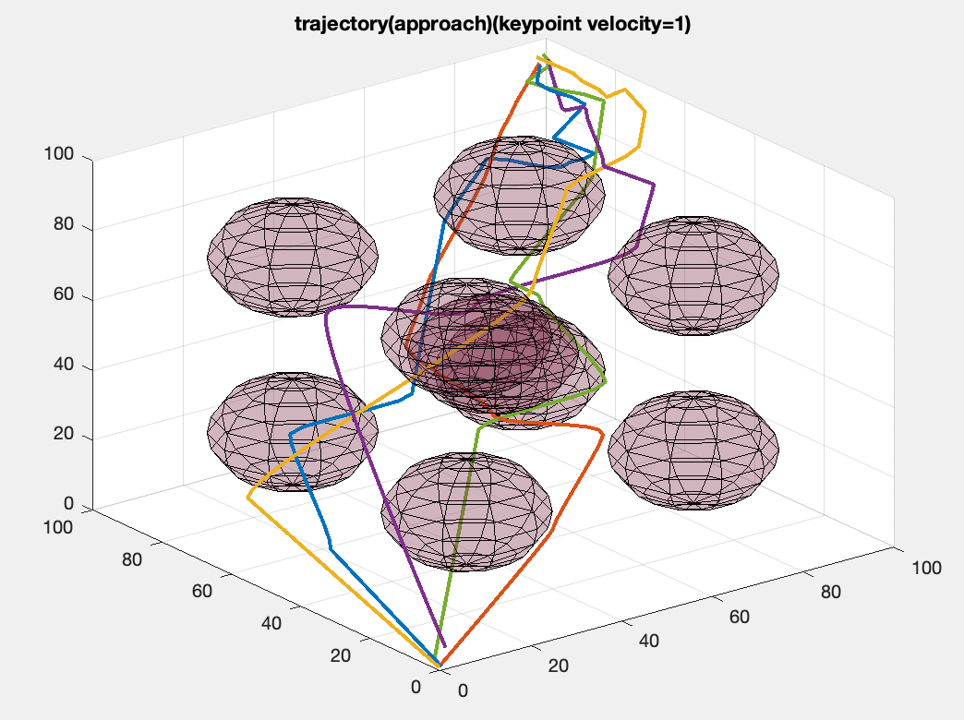
Method 2: Half approaching for a smooth trajectory
1. Calculate two trajectory. One is 0 velocity at keypoint, another has velocity at keypoint.
2. Judge whether collision or out of range happens, if happens. Generate a new trajectory between this two trajectory.
3. Judge collison and out of range again, if still happens, back to step 2. Make velocity trajectory gradually approches to non-velocity trajectory.

Slide 7
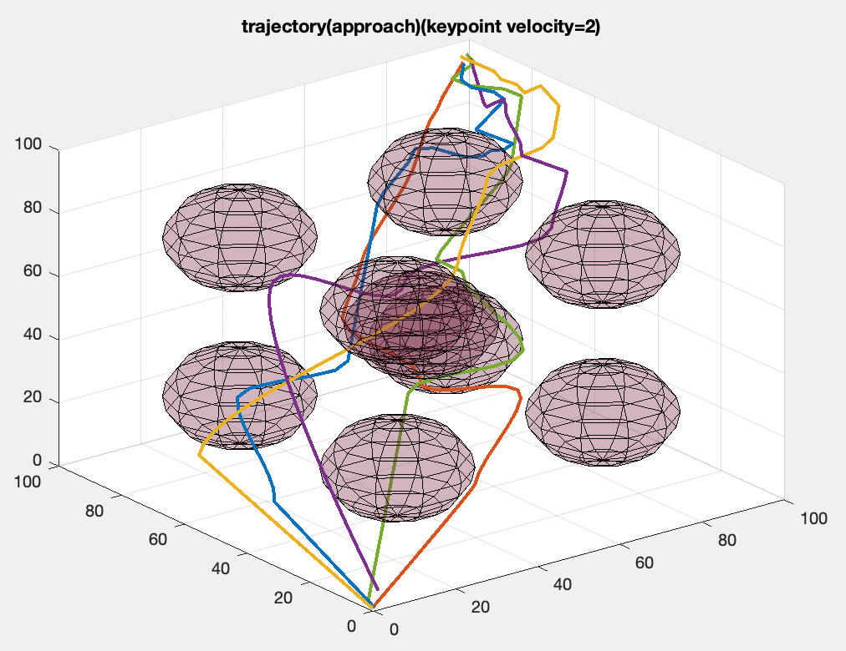
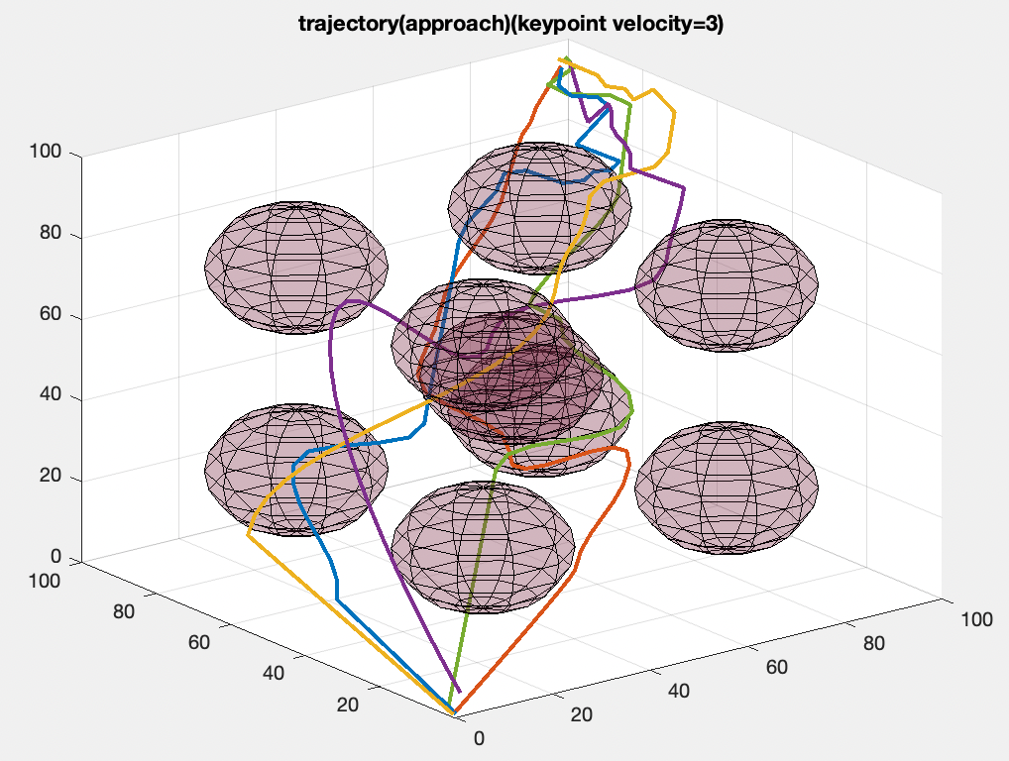

Slide 8
Comparison of two method
The difference of two method is not obvious when the velocity is small.
When the velocity is high, approaching method will generate a more smooth trajectory at turning point.

Slide 9
Other Work
Get familiar with overleaf(latex format)
Collect figures
Think about structure of final report

